Slide 1
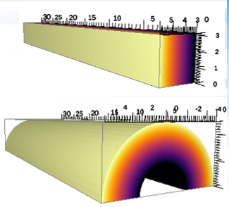
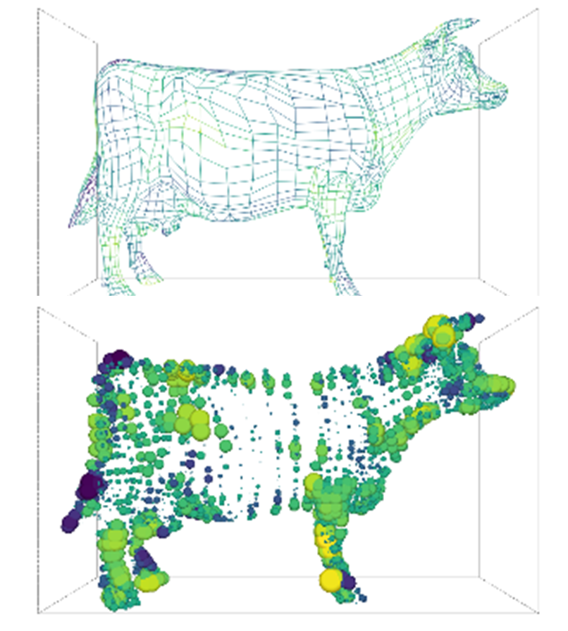
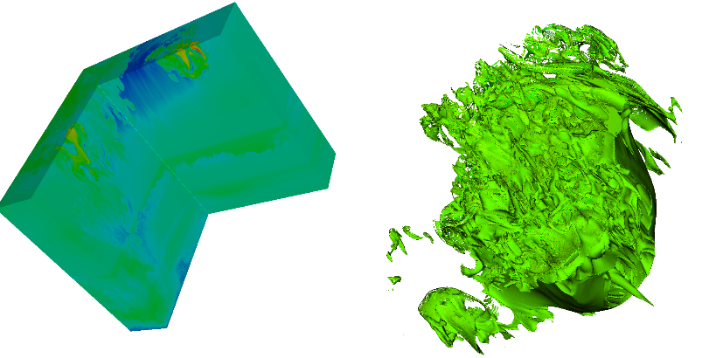


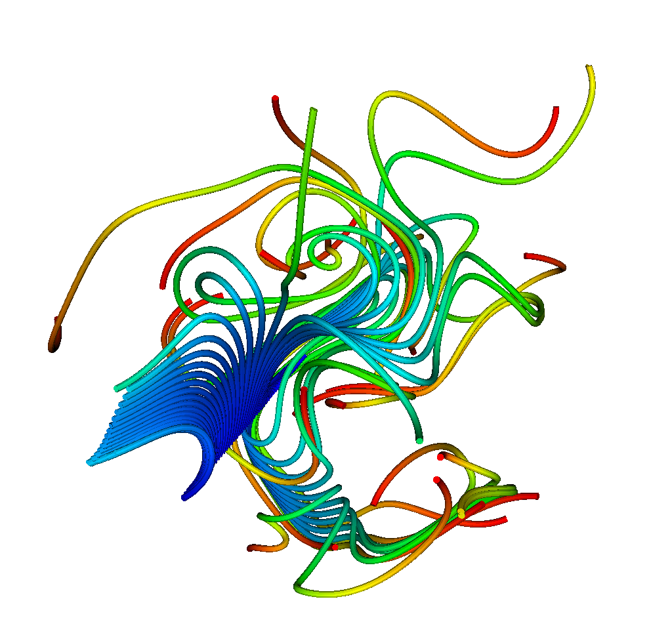
VTK-m Update
DOECGF 2019
April 23 or 24, 2019
Kenneth Moreland Sandia National Laboratories
with lots of contributions from the VTK-m community

Slide 2


Acknowledgements
This material is based upon work supported by the U.S. Department of Energy, Office of Science, Office of Advanced Scientific Computing Research, under Award Numbers 10-014707, 12-015215, and 14-017566.
This research was supported by the Exascale Computing Project (17-SC-20-SC), a collaborative effort of two U.S. Department of Energy organizations (Office of Science and the National Nuclear Security Administration) responsible for the planning and preparation of a capable exascale ecosystem, including software, applications, hardware, advanced system engineering, and early testbed platforms, in support of the nation’s exascale computing imperative.
Sandia National Laboratories is a multimission laboratory managed and operated by National Technology and Engineering Solutions of Sandia, LLC., a wholly owned subsidiary of Honeywell International, Inc., for the U.S. Department of Energy’s National Nuclear Security Administration under contract DE-NA-0003525.
Thanks to many, many partners in labs, universities, and industry.

Slide 3
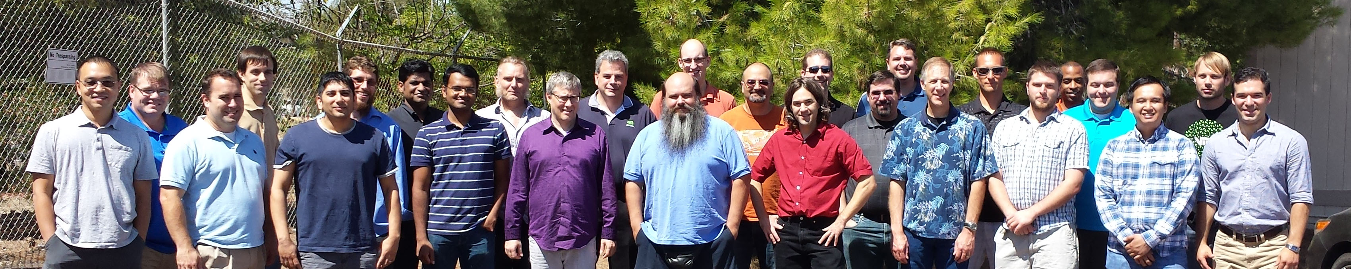
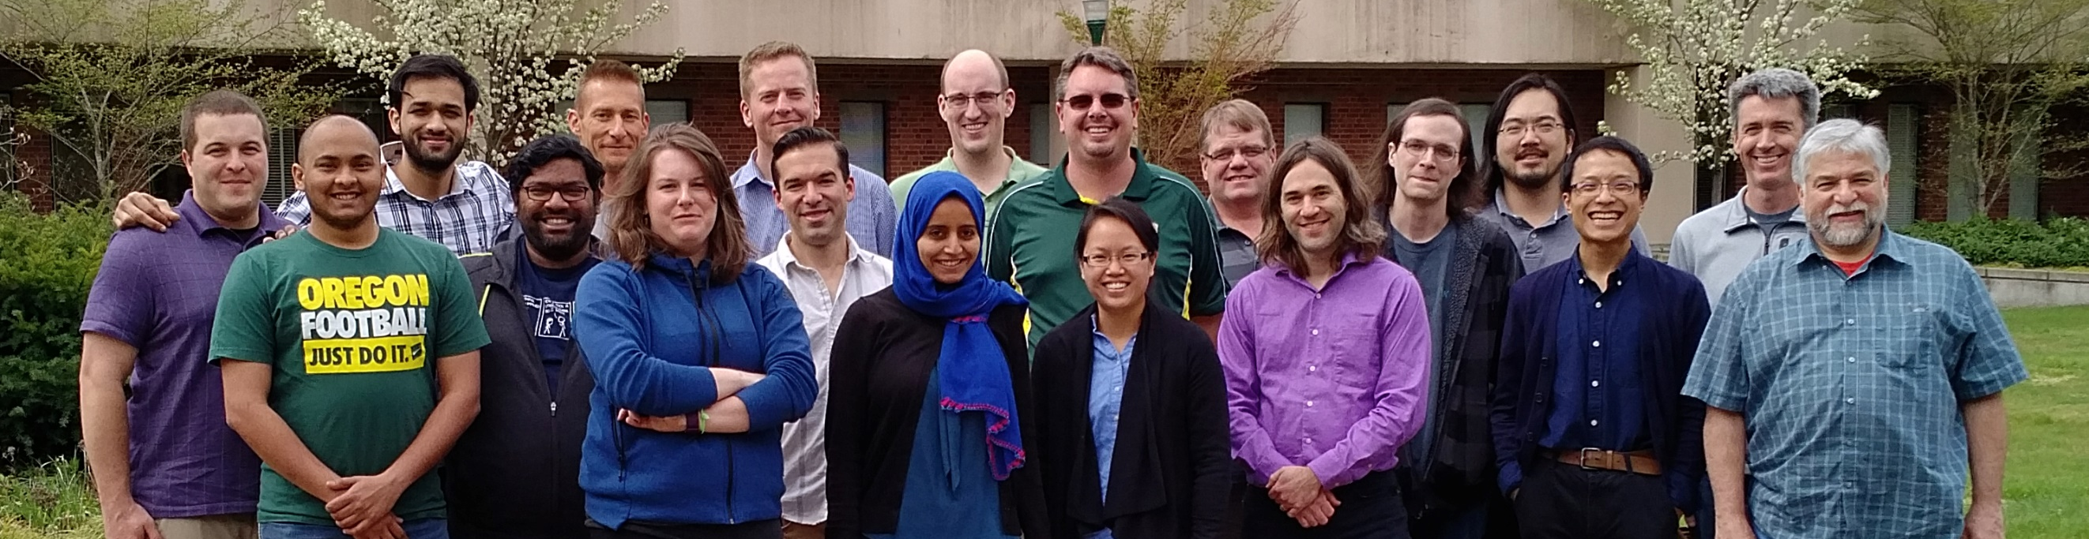
Thanks to All Our Partners!
Code Sprint, September 2015, LLNL
Code Sprint, April 2017, University of Oregon

Slide 4
Why VTK-m?

Slide 5
My new computer's got the clocks, it rocks
But it was obsolete before I opened the box
− “Weird” Al Yankovic, It’s All About the Pentiums, circa 1999
Moore’s Law is dead.
− Gordon Moore, circa 2005
Notes:
Why is this happening now?
In previous years we enjoyed a doubling of clock rate every 18 months
Frustrating to computer buyers but great for HPC
(Technically, it’s Dennard scaling, that power in transistors drops as they shrink, that is dead.)
Now, clock rates have leveled off at 2-4 GHz
Manufactures compensate by adding more cores, more parallelism

Slide 6
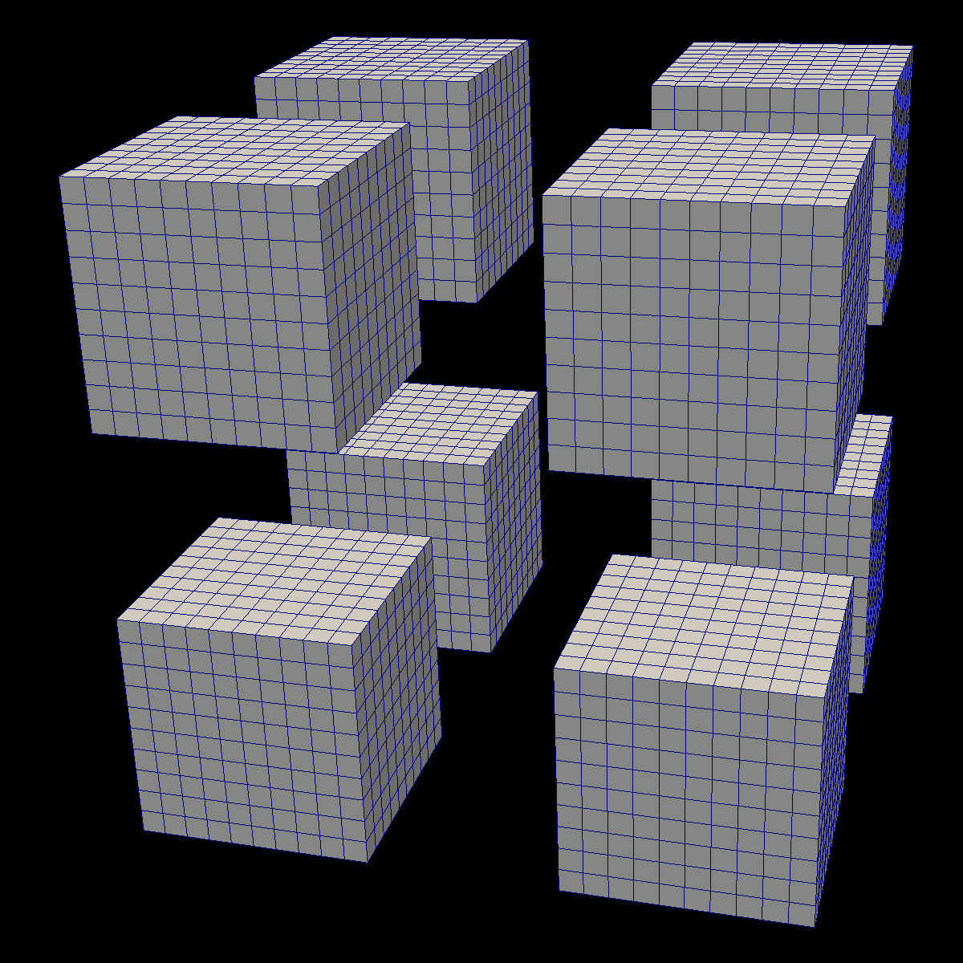
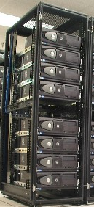


Distributed
Parallelism
ALPINE/
ASCENT

Slide 7
Distributed
Parallelism
ALPINE/
ASCENT
On Node
Parallelism

Slide 8
VTK-m: the ’m’ is for many-core
VTK:
popular, open source, supported by a community
… but primarily single core only.
VTK-m:
name chosen to evoke the positive attributes of VTK
… but will support multi-core and many-core.
VTK-m is the only DOE effort for many-core visualization.
Previously there were 3 predecessor projects, but the PI’s of those projects decided to join forces in 2014 to make VTK-m.

Slide 9
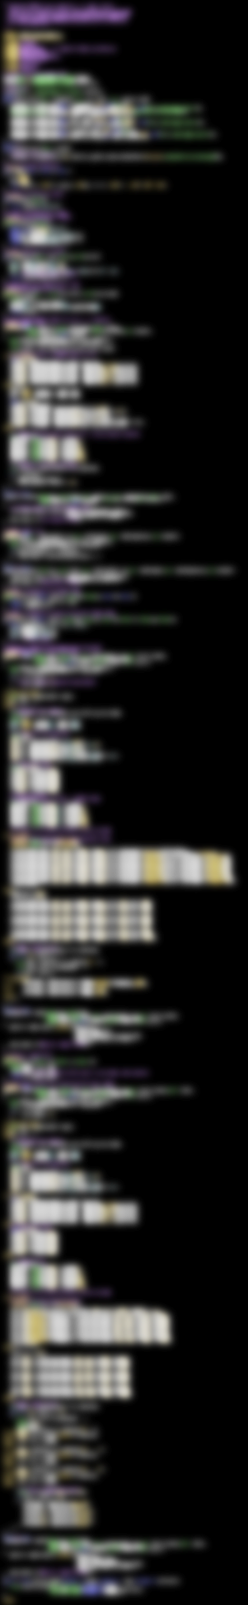

VTK-m
283 Lines
CUDA SDK
561 Lines
Notes:
The source code of Marching Cubes in three different packages. Case tables removed (all essentially the same).
CUDA SDK: marchingCubes_kernel.cu
VTK-m: IsosurfaceUniformGrid.h

Slide 10

Isosurface
Streamline
Clip
Render
GPU
CPU
TBB
OpenMP

Slide 11
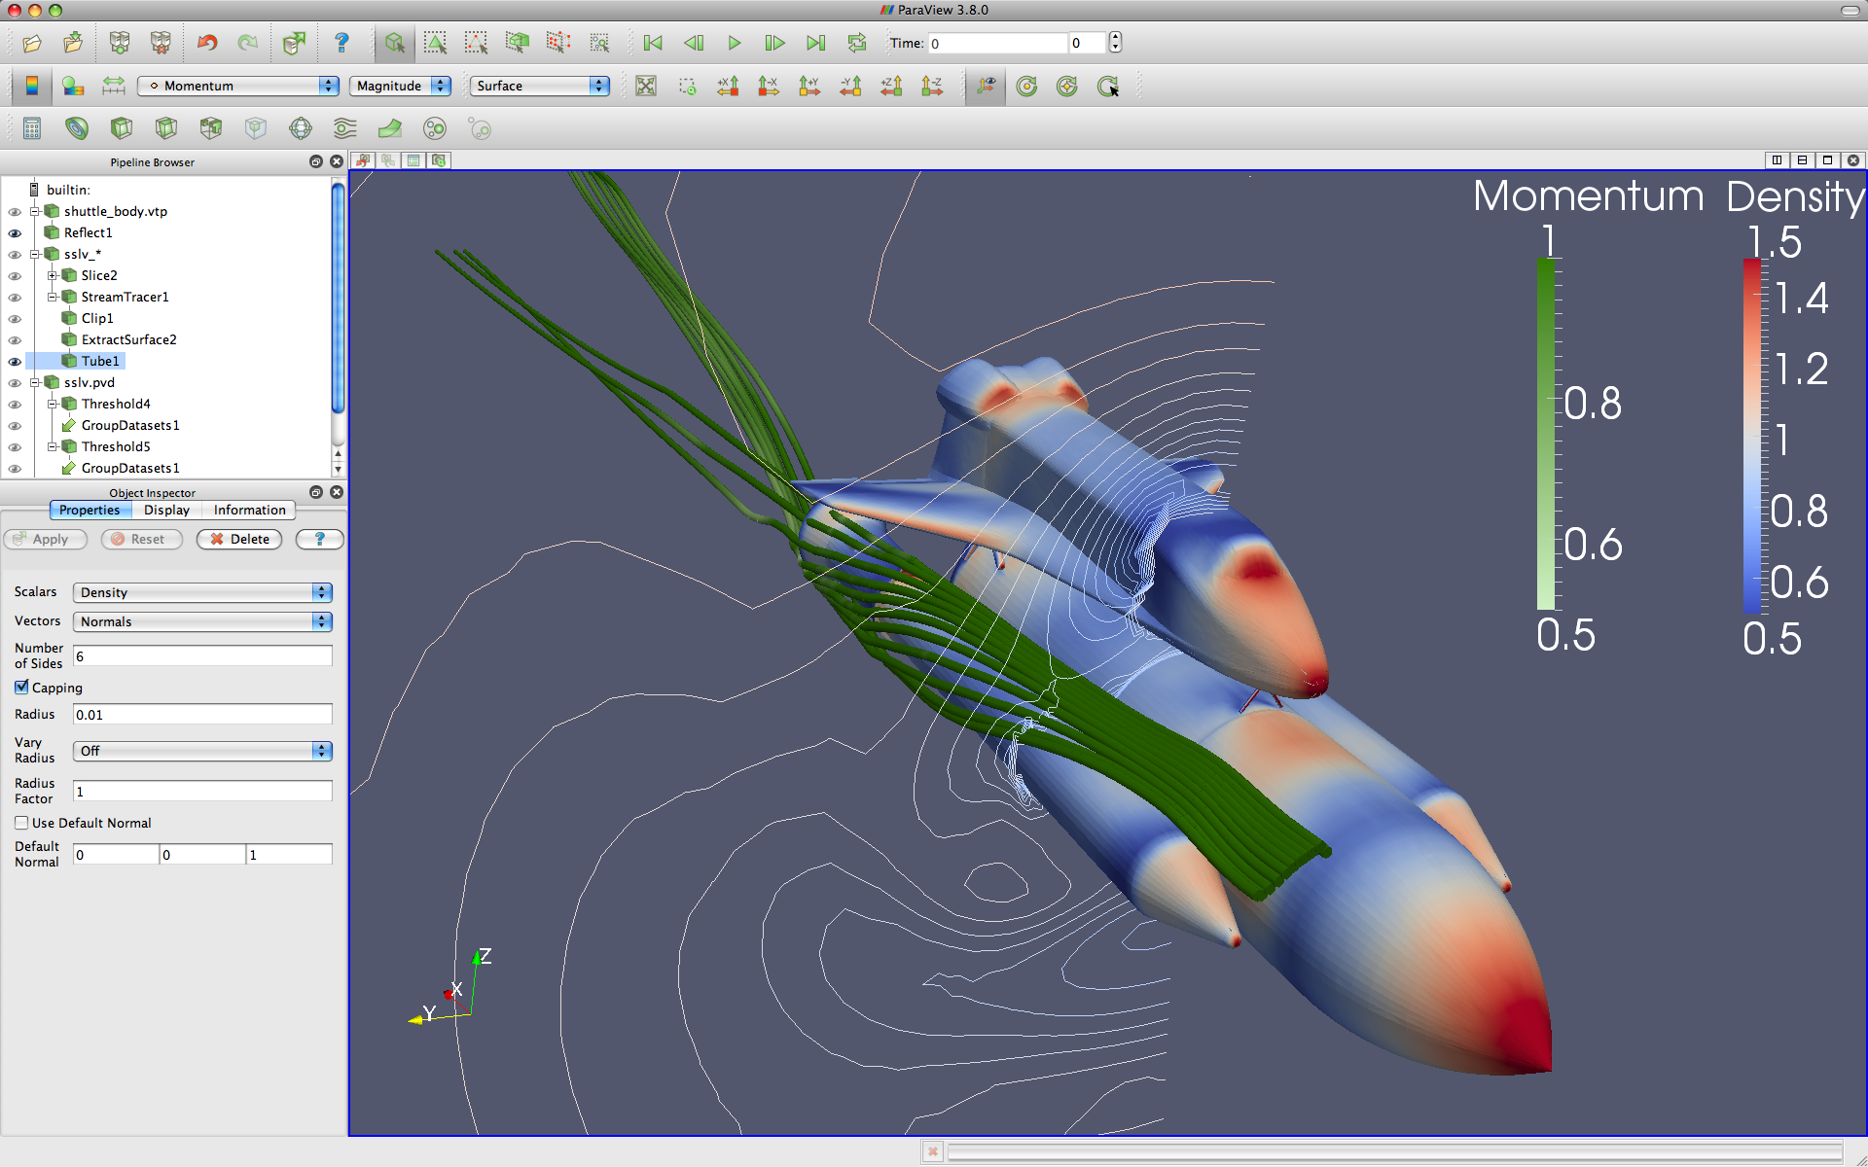



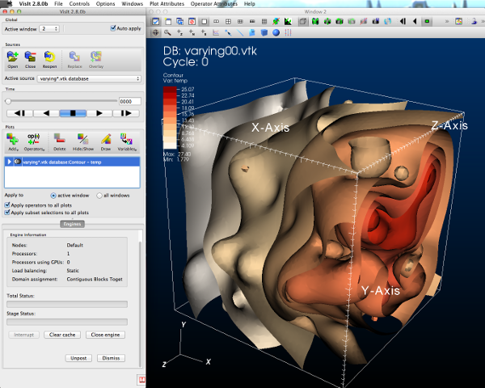



GUI / Parallel Management
Simulations
In Situ Vis Library
(Integration with Sim)
Base Vis Library
(Algorithm Implementation)
Libsim
Multithreaded Algorithms
Processor Portability

Slide 12
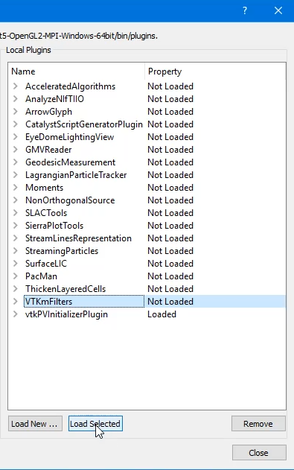
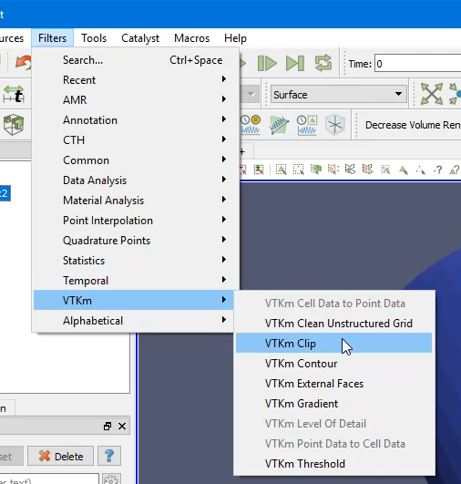
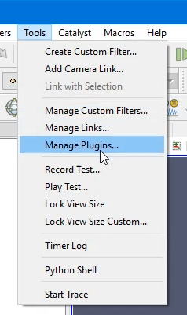
Using VTK-m in ParaView
1. Load VTK-m Plugin
2. Use a VTK-m filter like any other

Slide 13
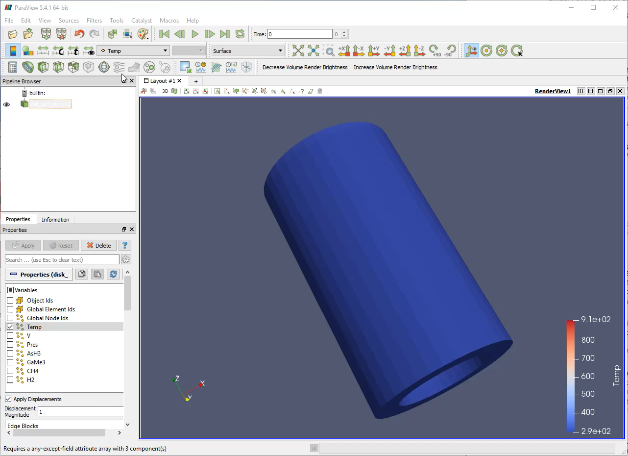

Slide 14
Using VTK-m in VisIt
1. Turn on VTK-m in Preferences
2. Use VTK-m-enabled plots as normal
Slide Credit: David Pugmire

Slide 15
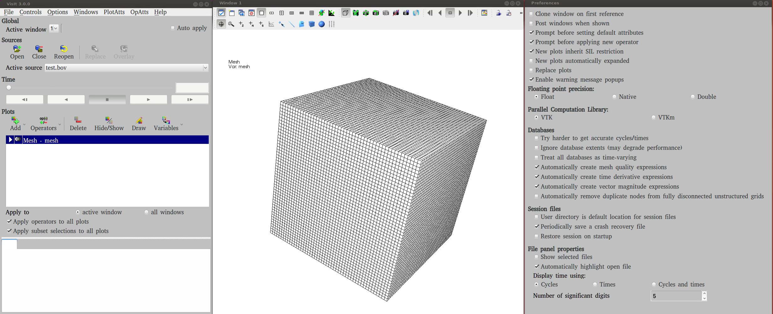
Slide Credit: David Pugmire

Slide 16
What is Going on Now?

Slide 17
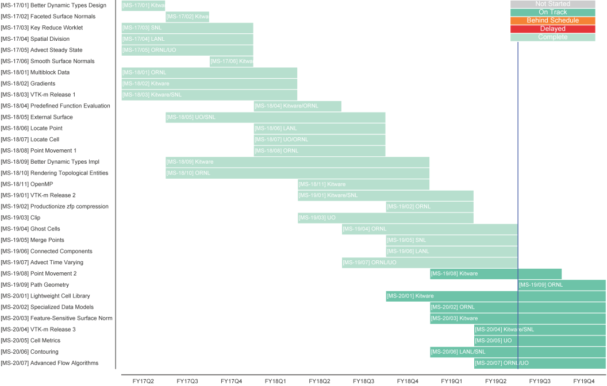
ECP/VTK-m Schedule

Slide 18
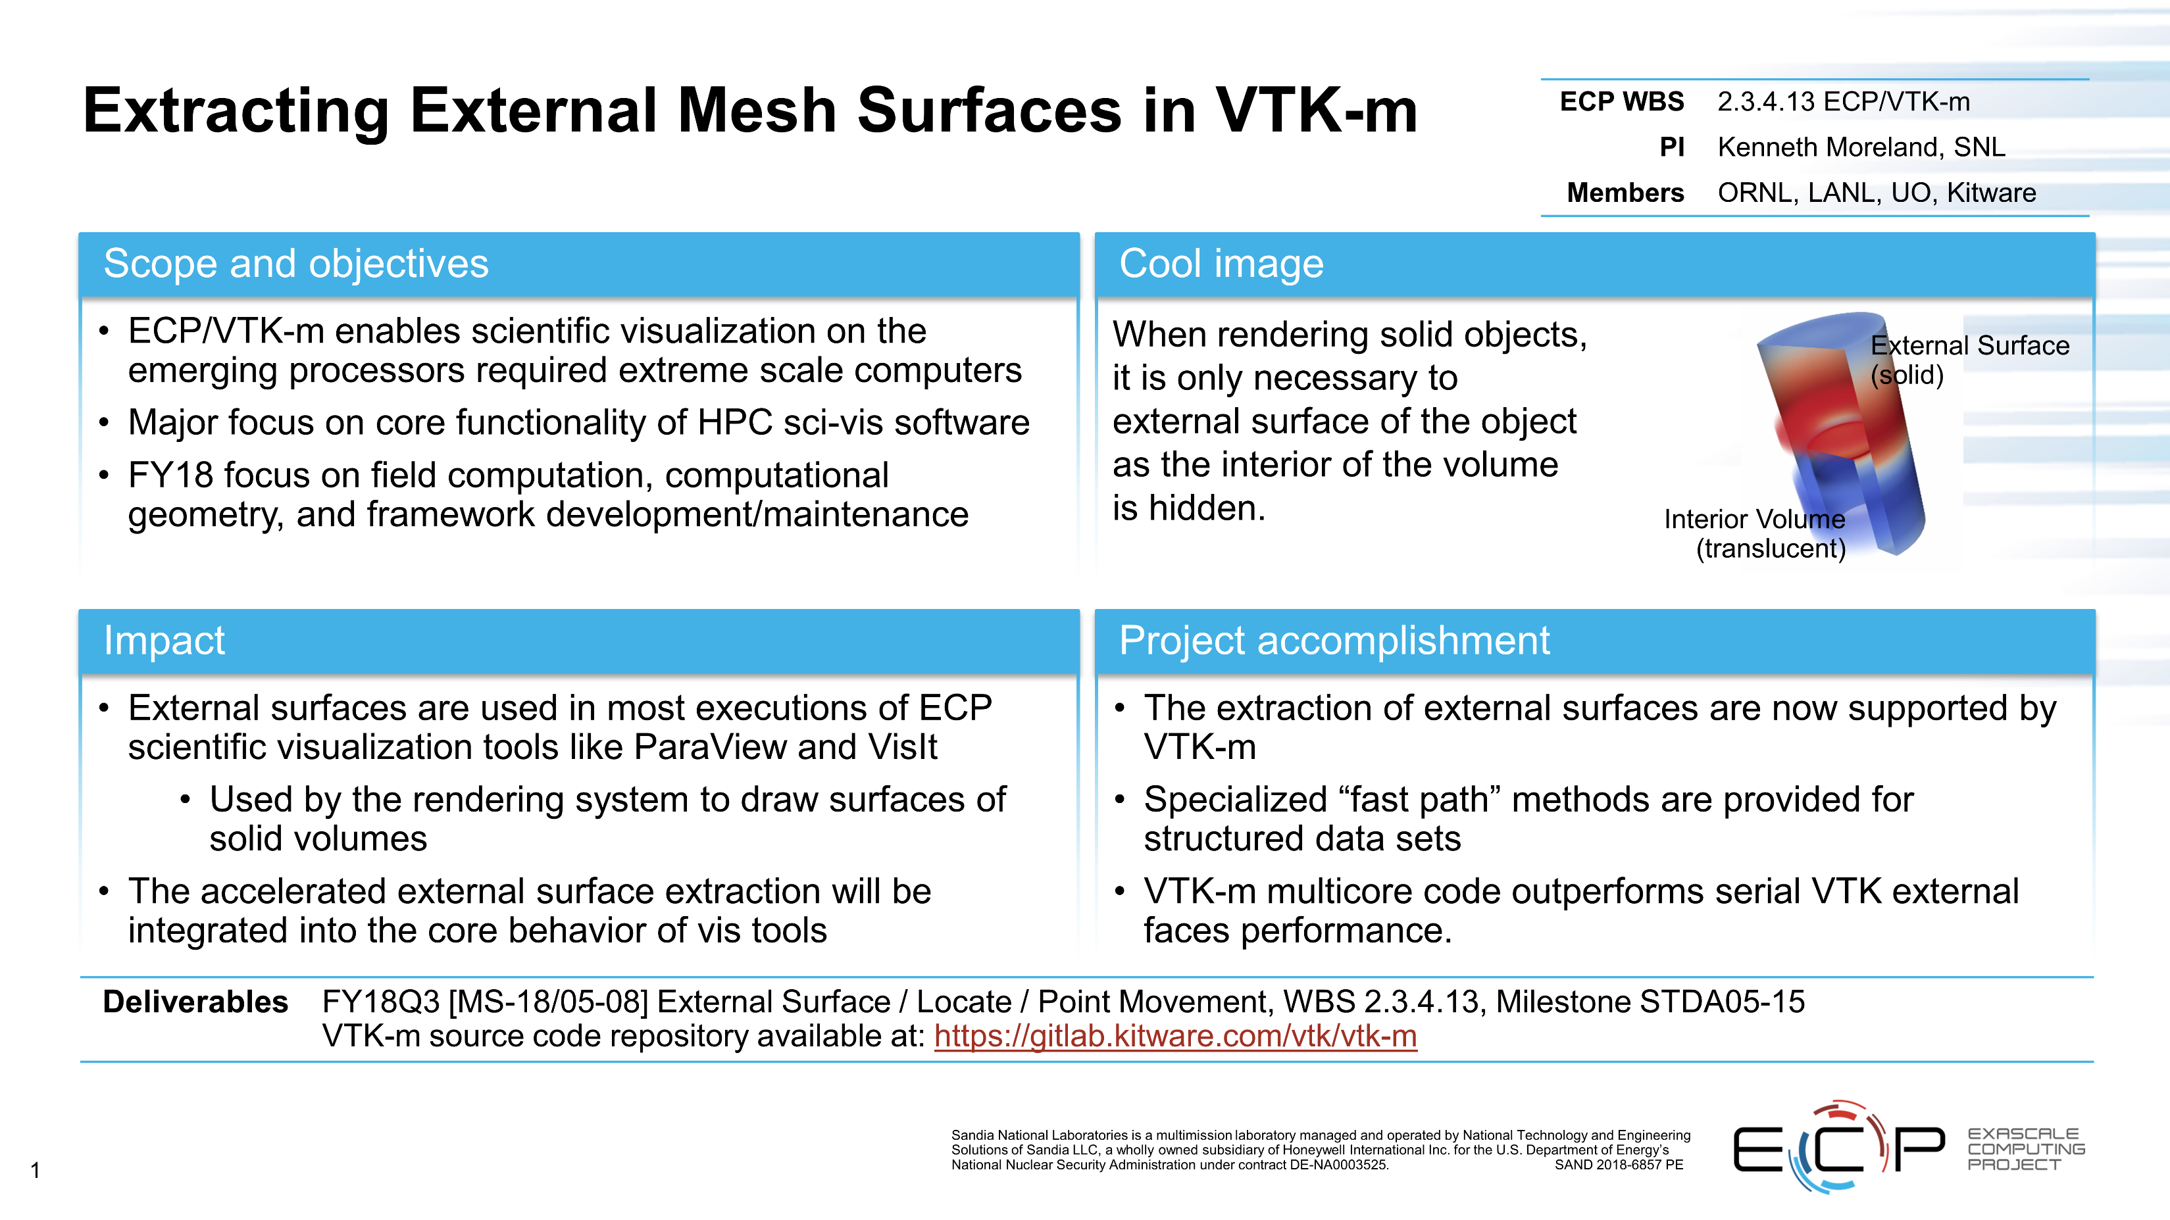

Slide 19
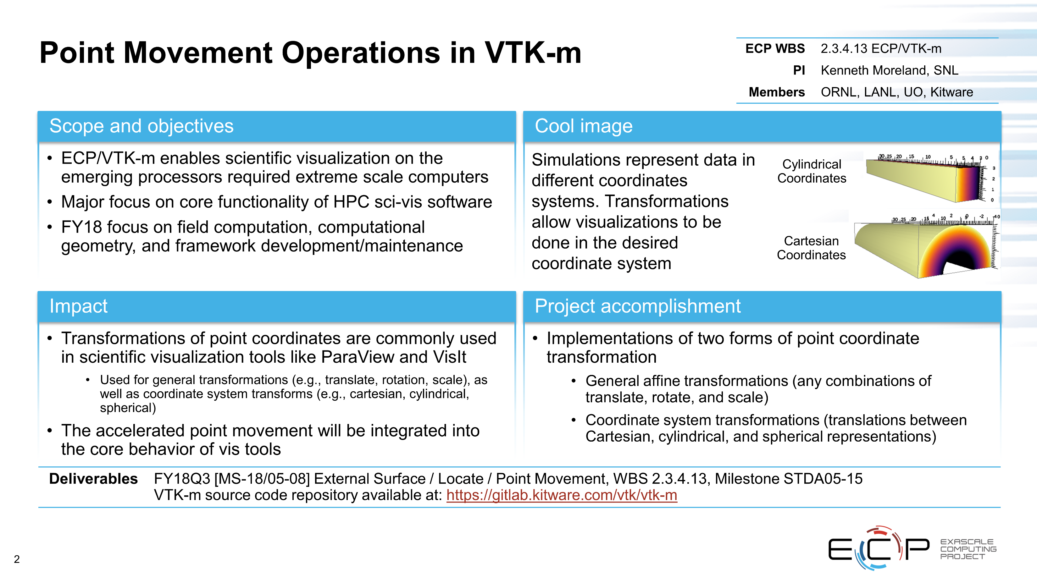

Slide 20
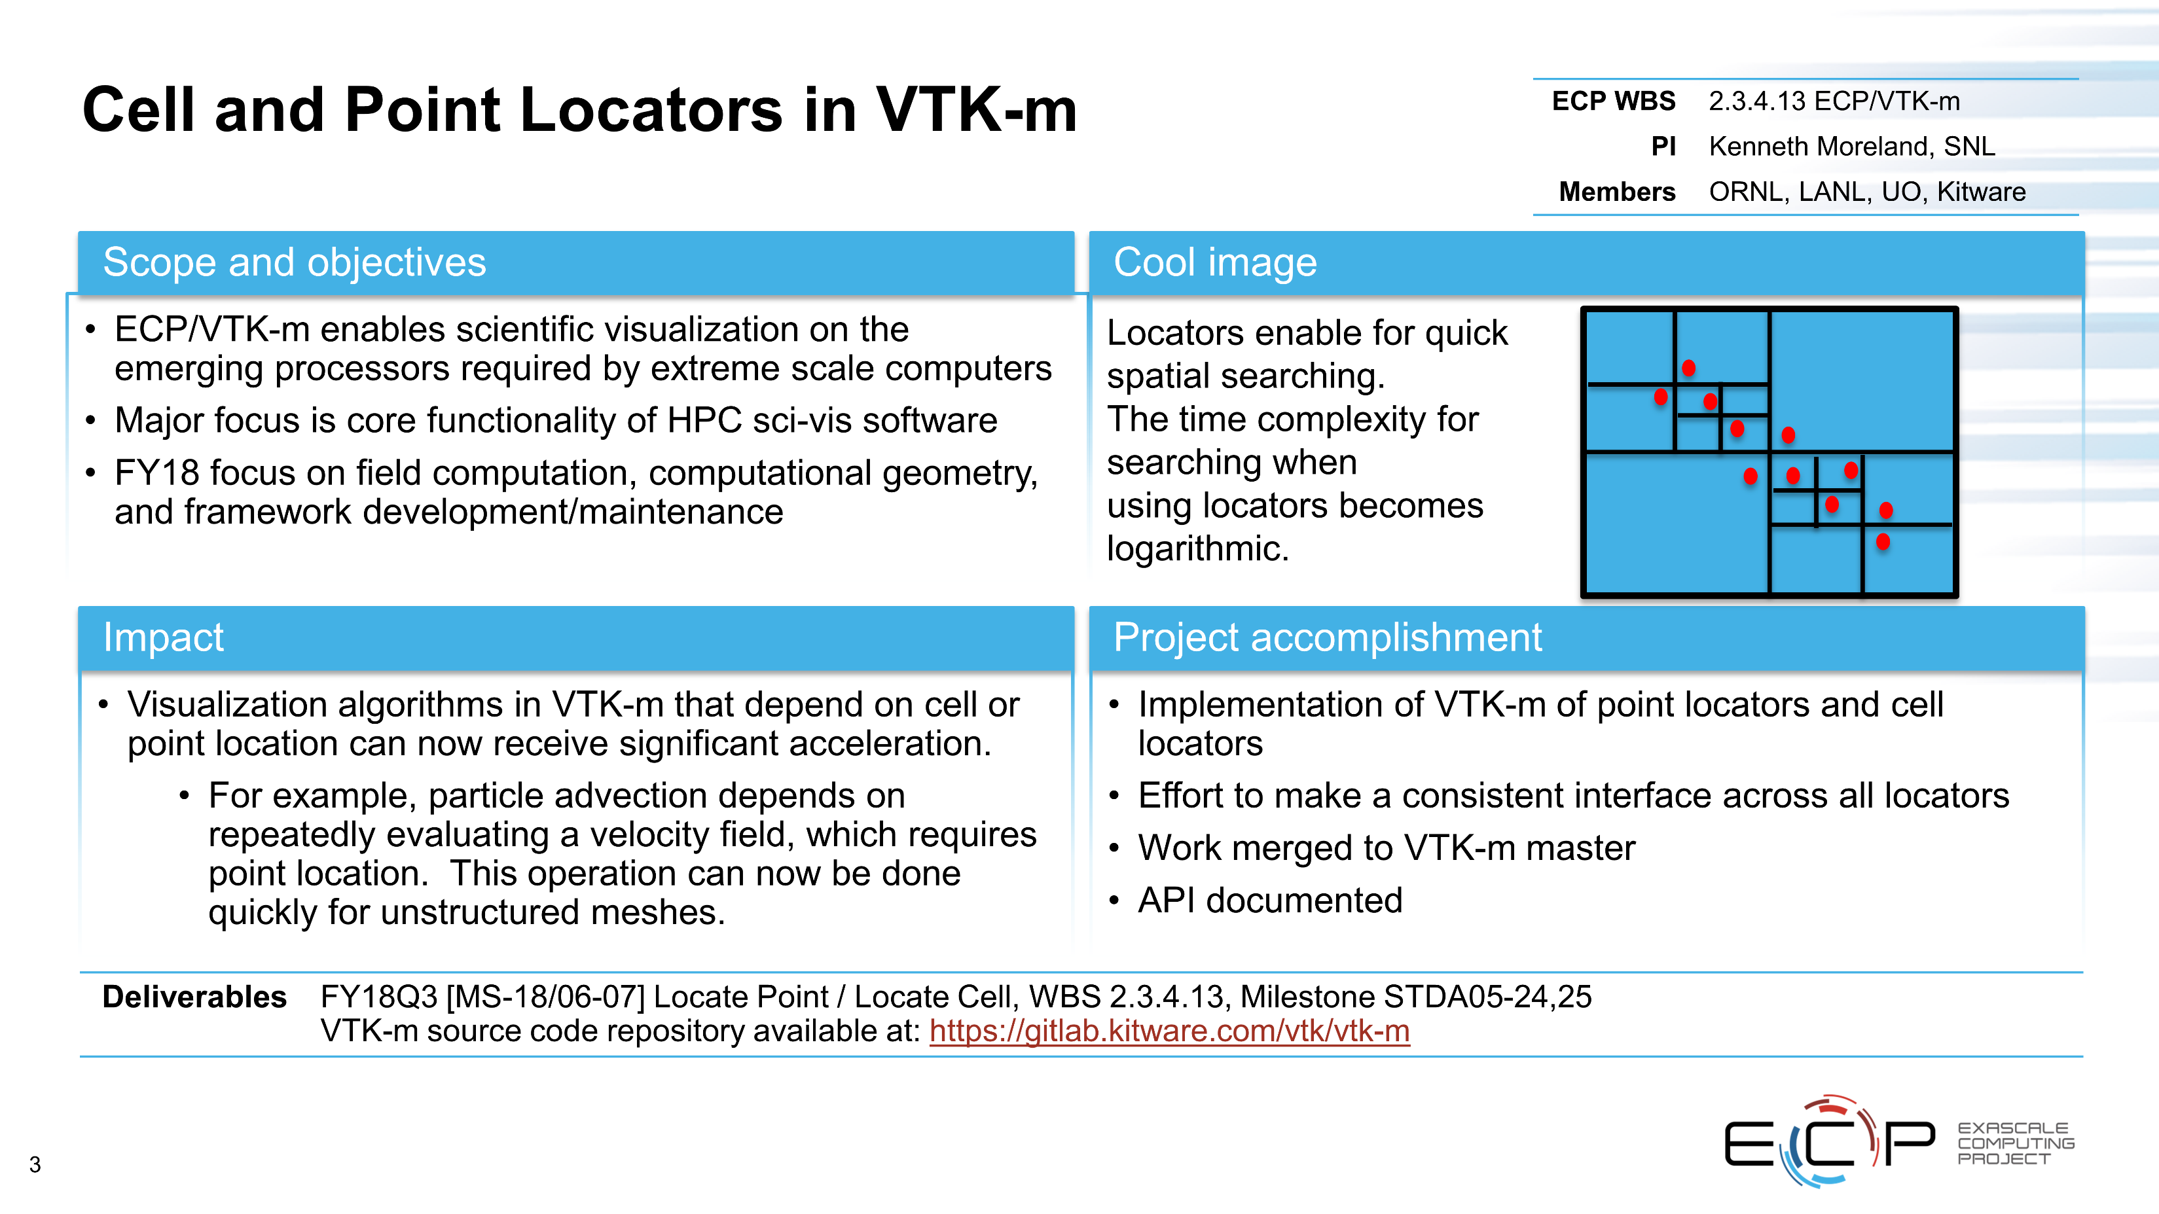

Slide 21
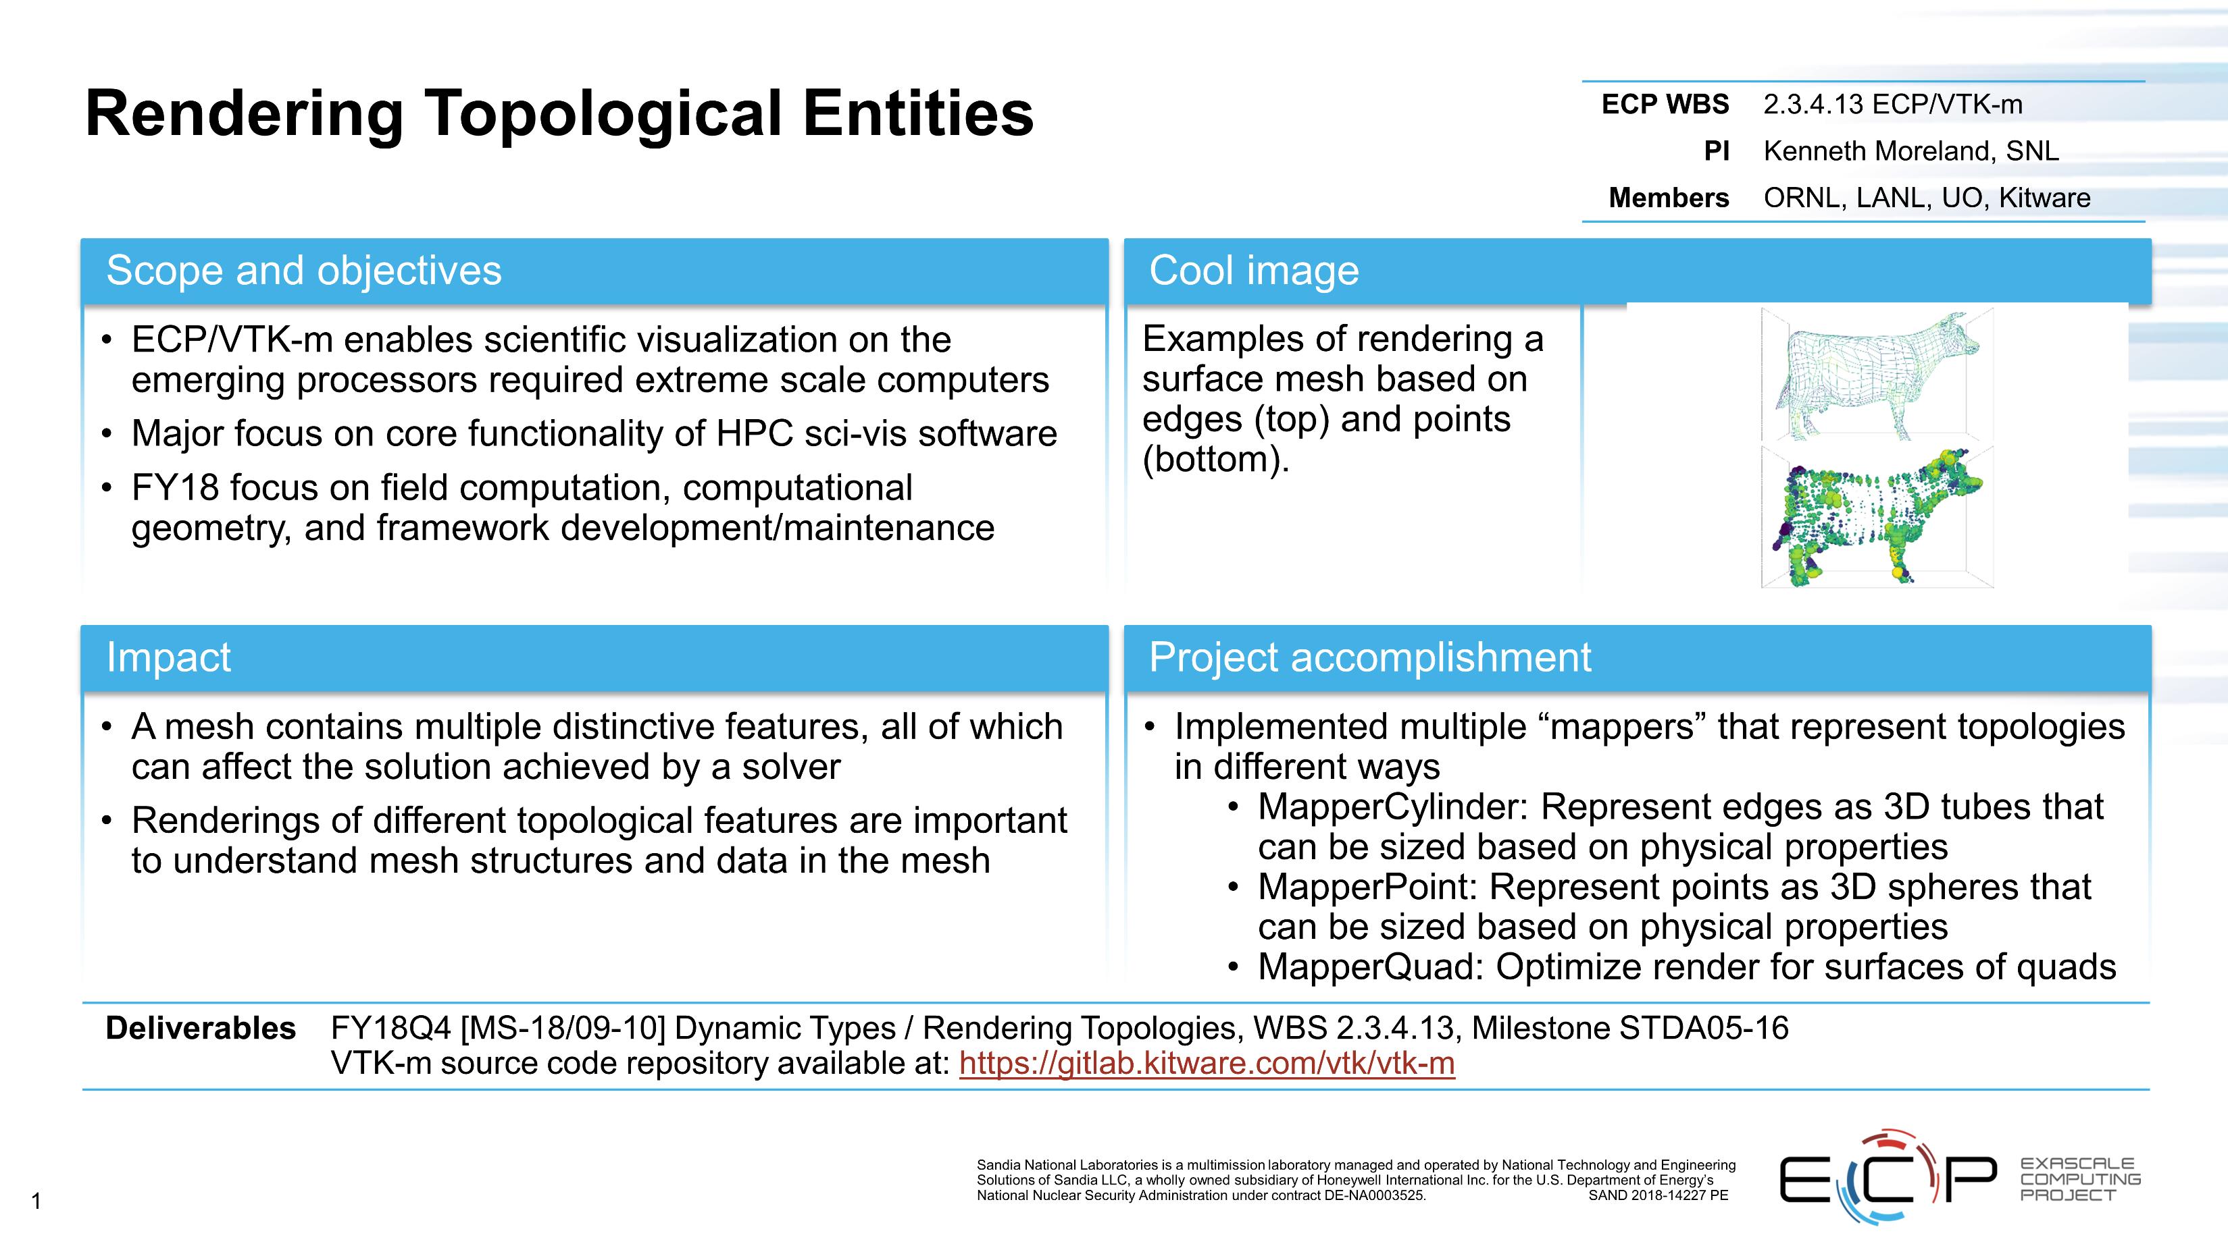

Slide 22
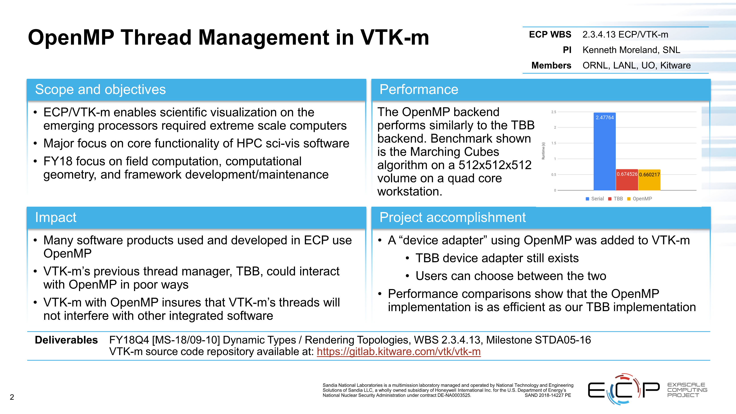

Slide 23
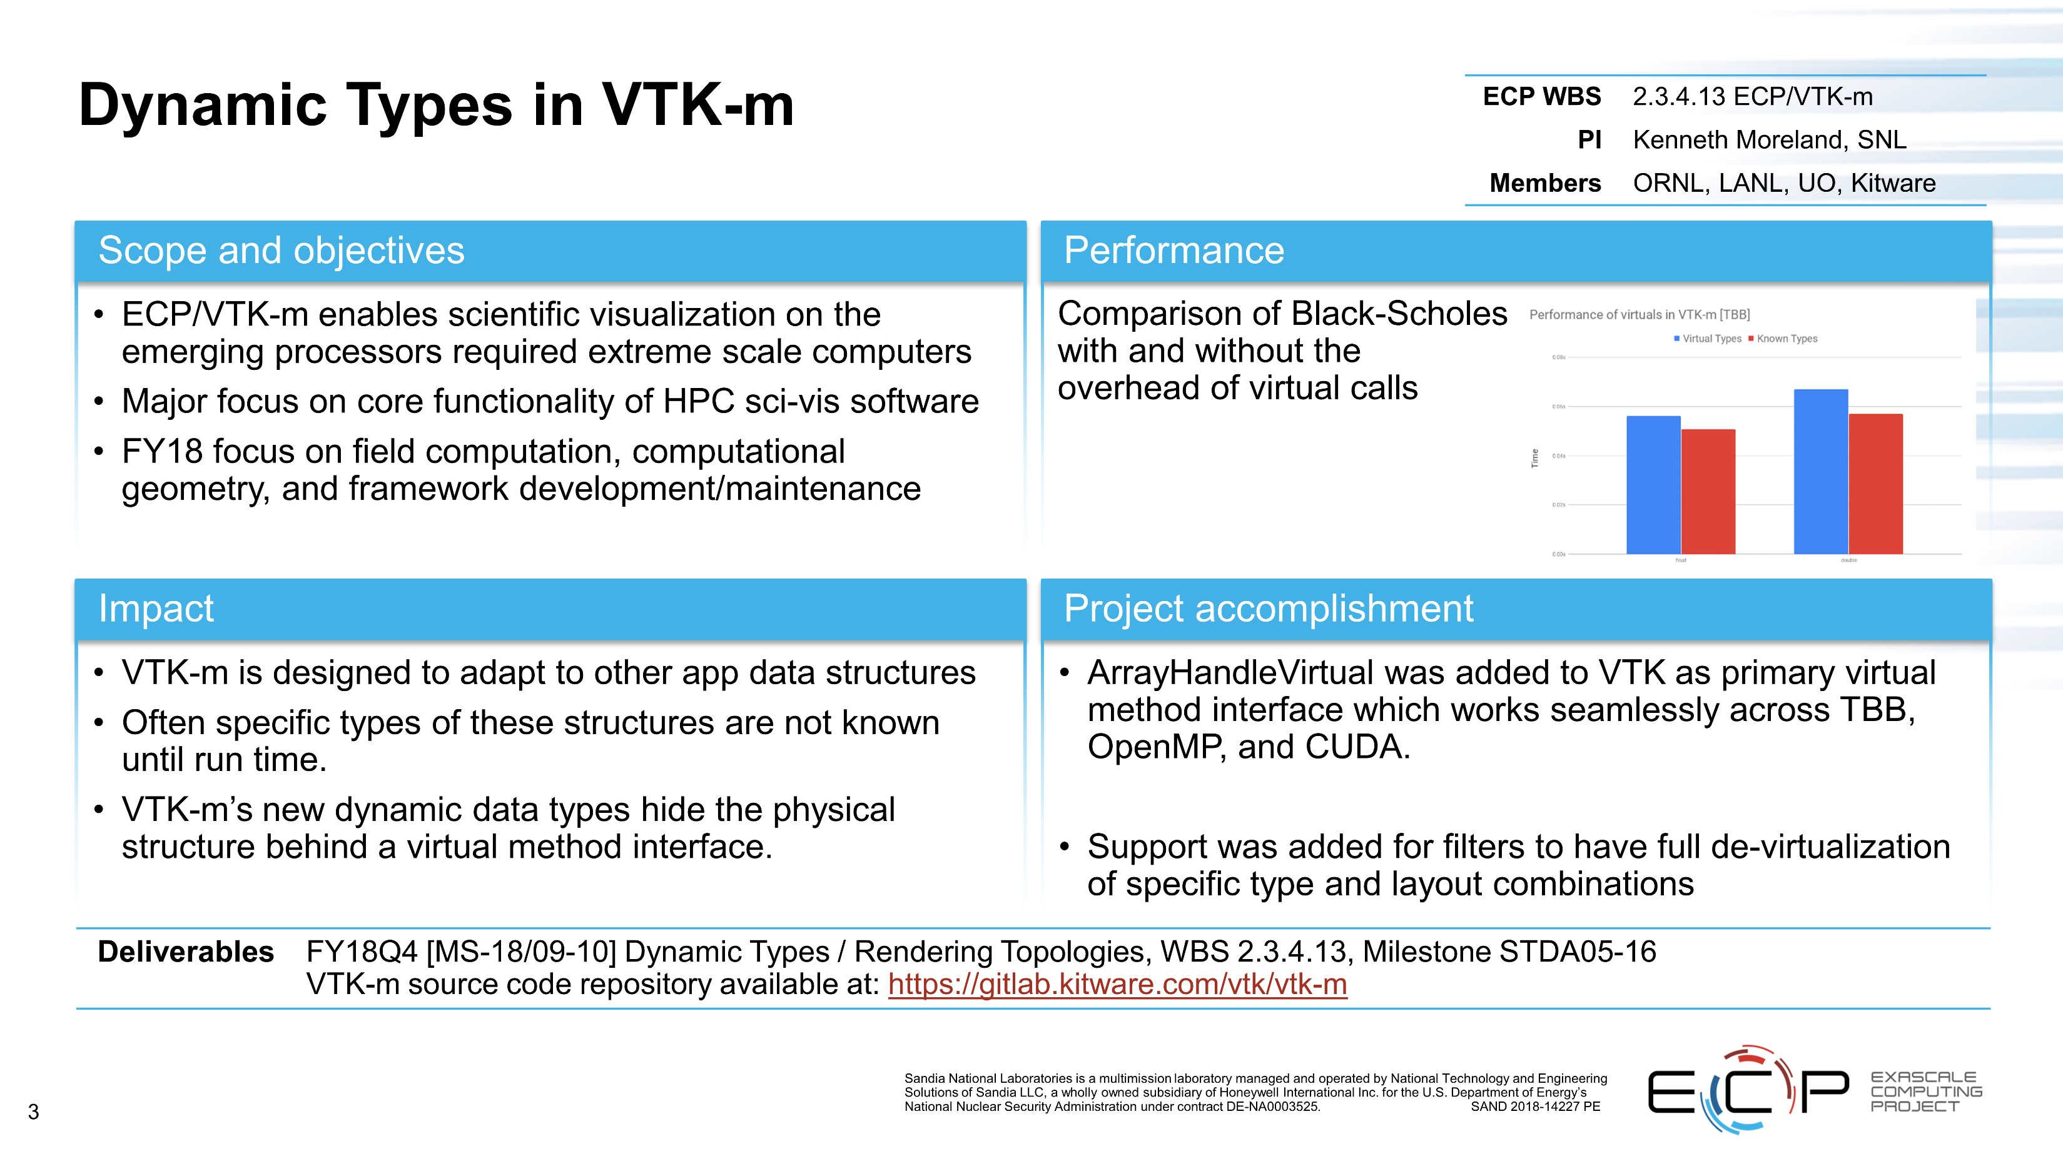

Slide 24
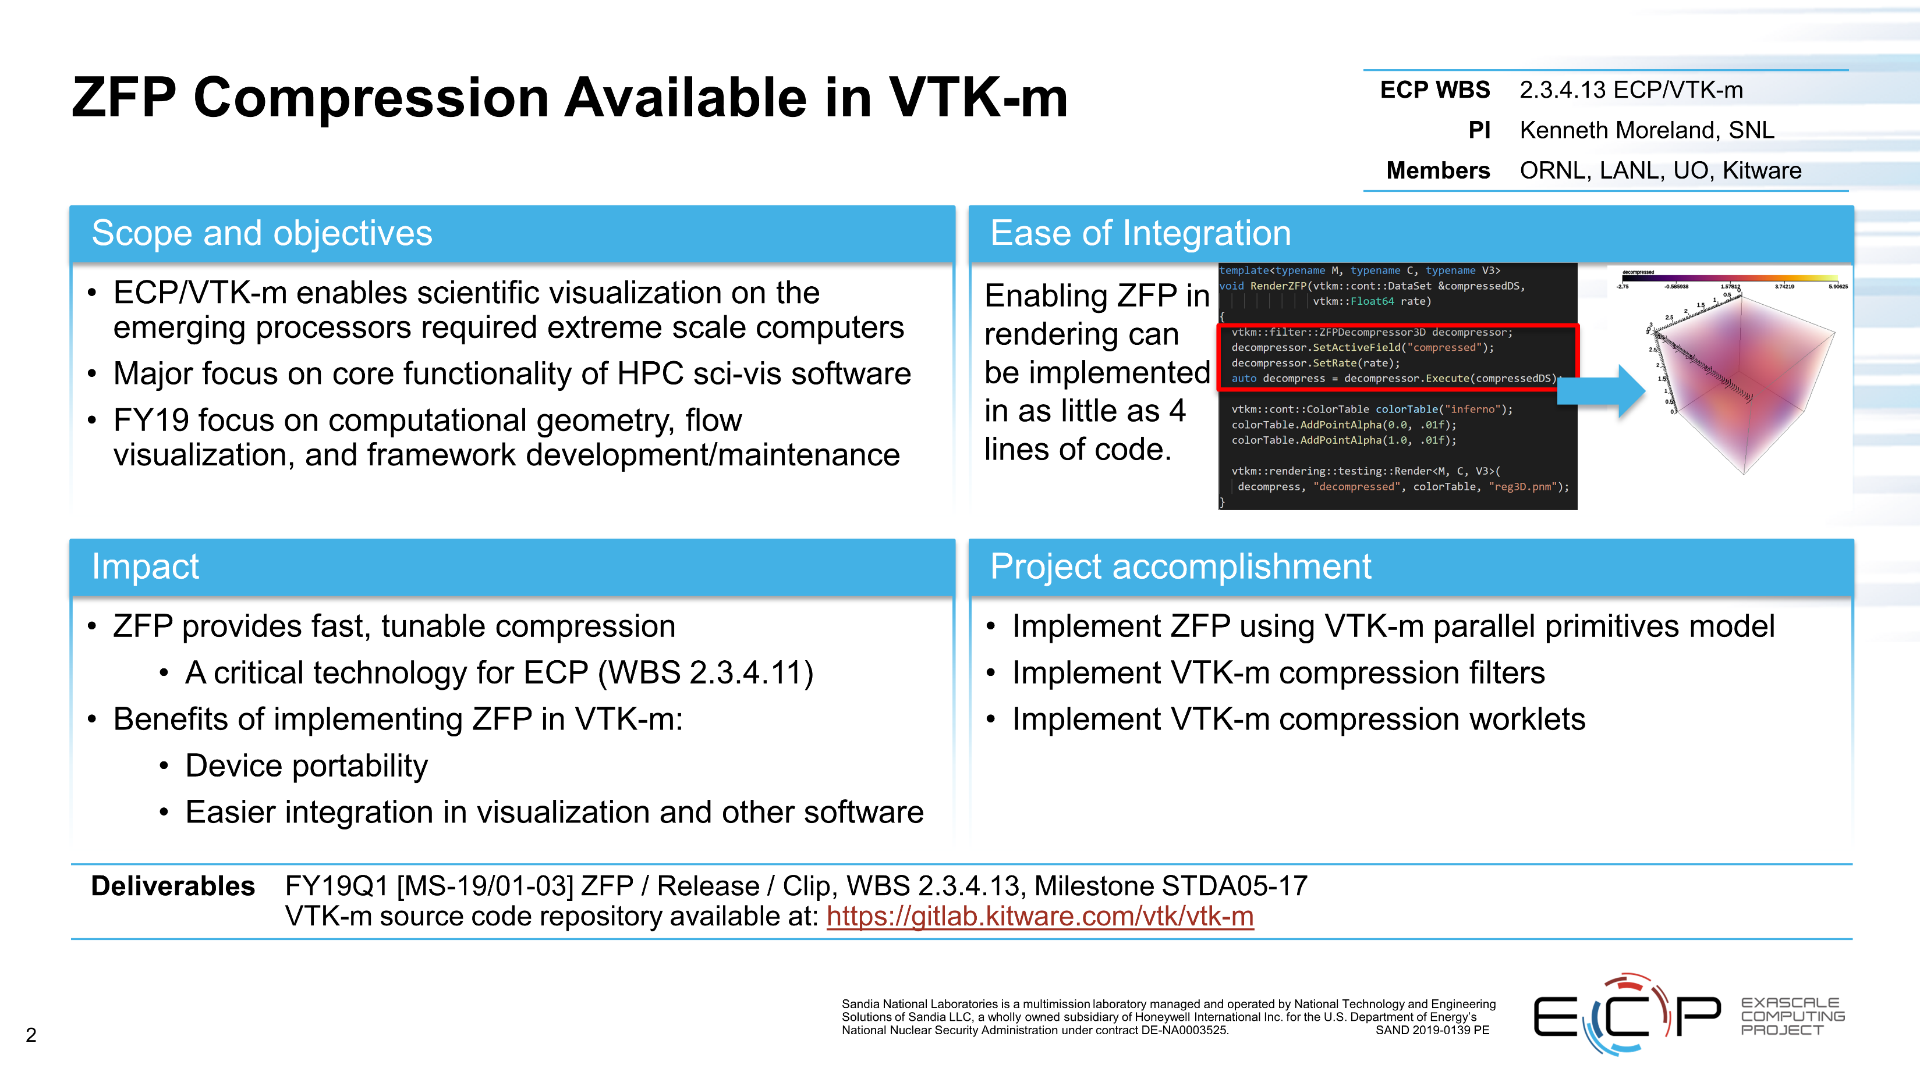

Slide 25
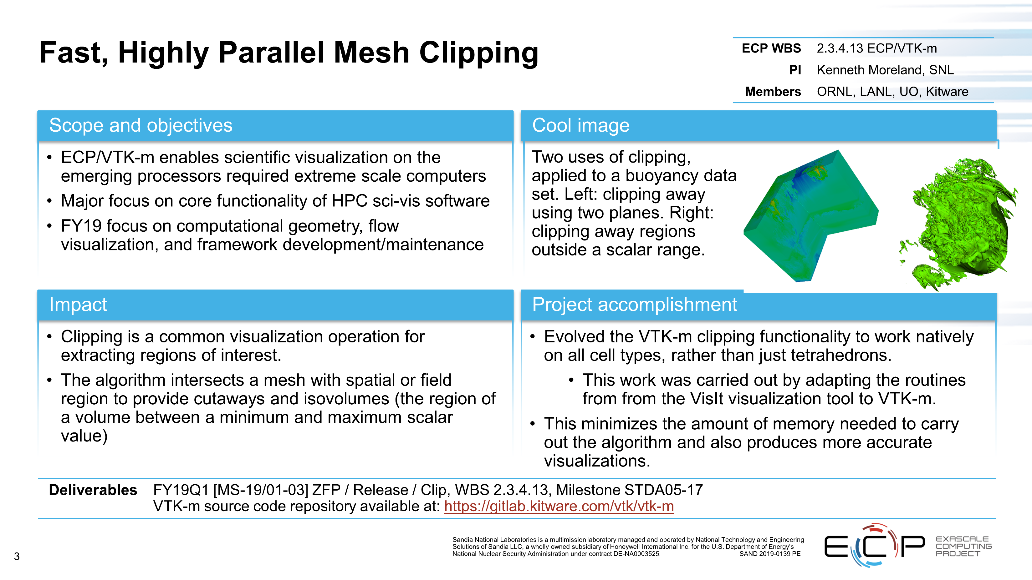

Slide 26
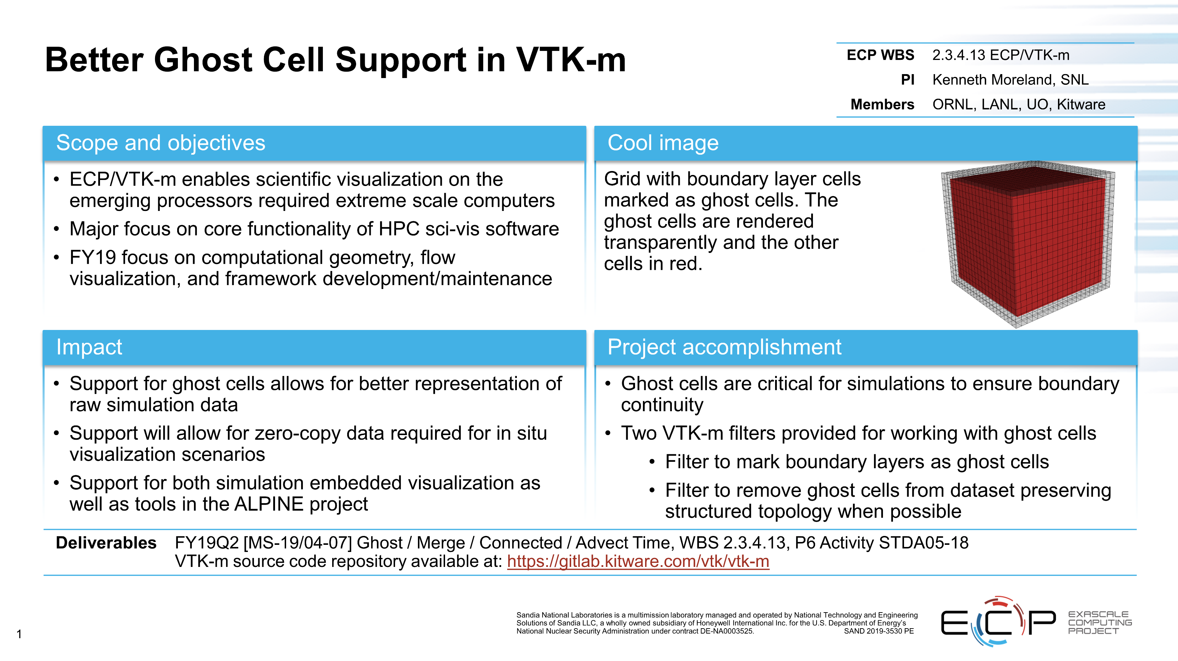

Slide 27
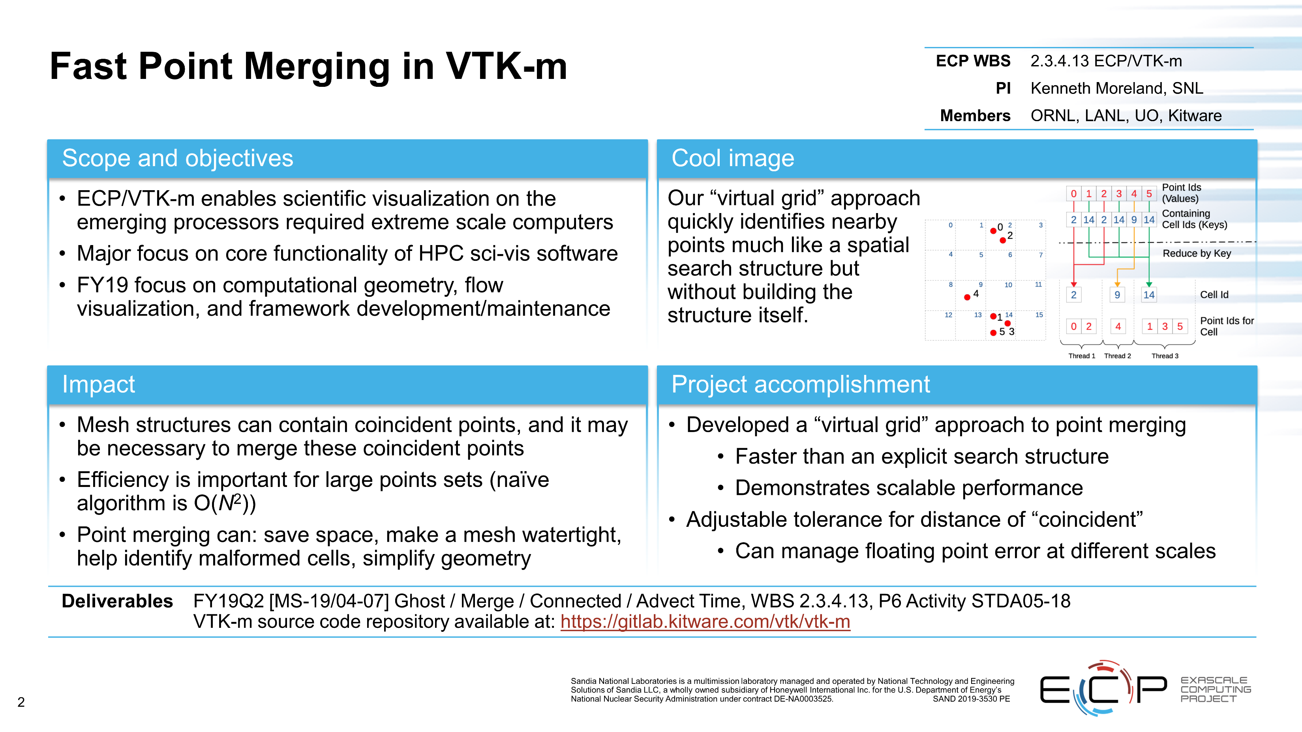

Slide 28
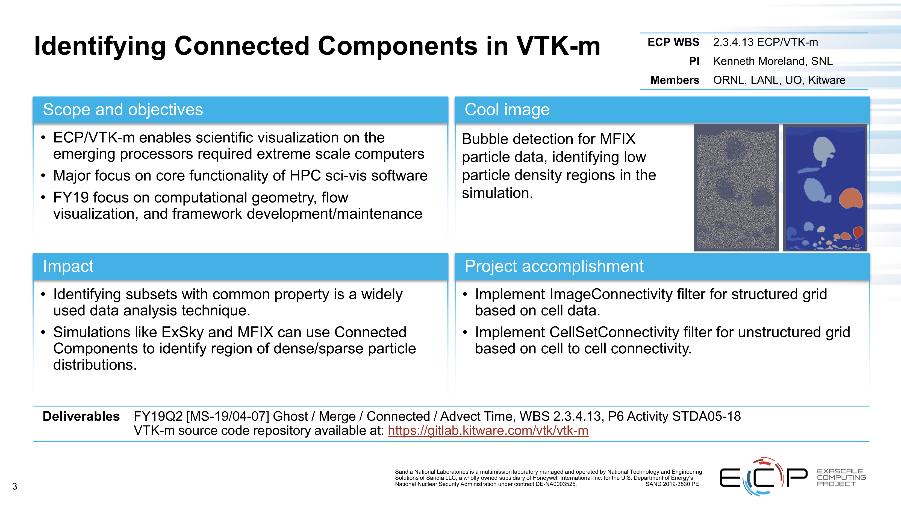

Slide 29
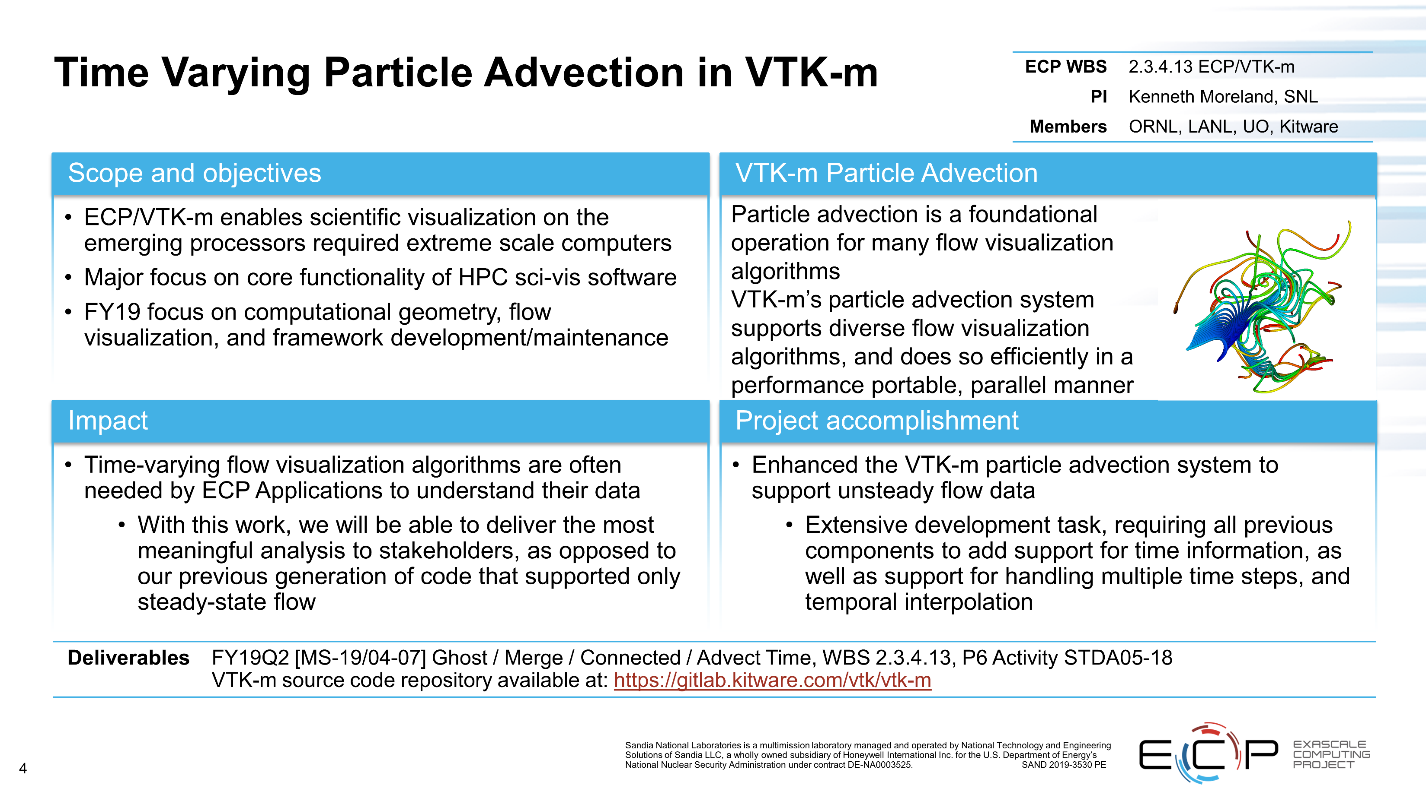

Slide 30

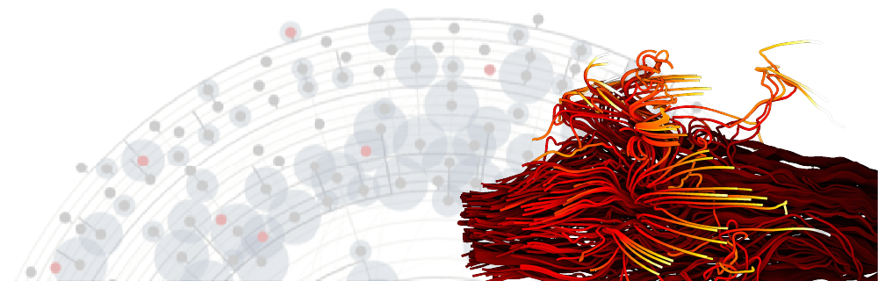
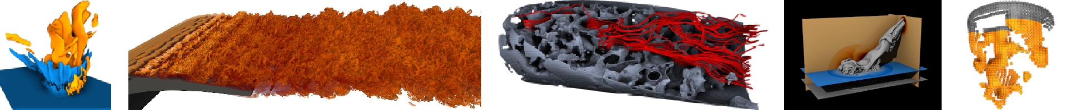
The 9th IEEE Symposium on Large Data Analysis and Visualization
in conjunction with IEEE VIS 2019,
Vancouver, BC, Canada, October 21, 2019
Abstracts Due: June 17
Papers Due: June 24

